Slide 1

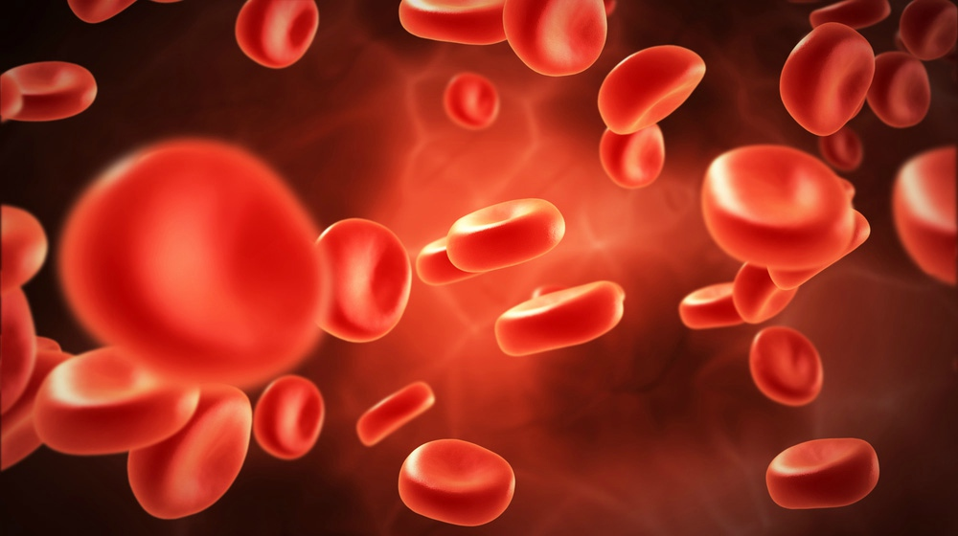
HEMOPHILIA
Name: Rishika Singh
Class: Pharm D – 1st Year
Roll no: 211411001

Slide 2
CONTENTS
What is Hemophilia?
History
Causes
Types of Hemophilia
Symptoms
Conclusion
Summary
Reference

Slide 3
What is hemophilia?
Hemophilia is a common hereditary coagulation blood disorder due to deficiency or reduced activity of clotting factor VIII or clothing factor IX . This order is an X lined recessive disorder. Hemophilia is a bleeding disorder that slows down the blood clothing process.
It's transmitted via females to men who sufferers.
Females who carry single mutated gene – Asymptomatic & not Affected.
Have longer bleeding problem after contact to some sort of injury.
People who have Severe Hemophilia starts – spontaneous bleeding in joints and muscles all around their bodies.

Slide 4
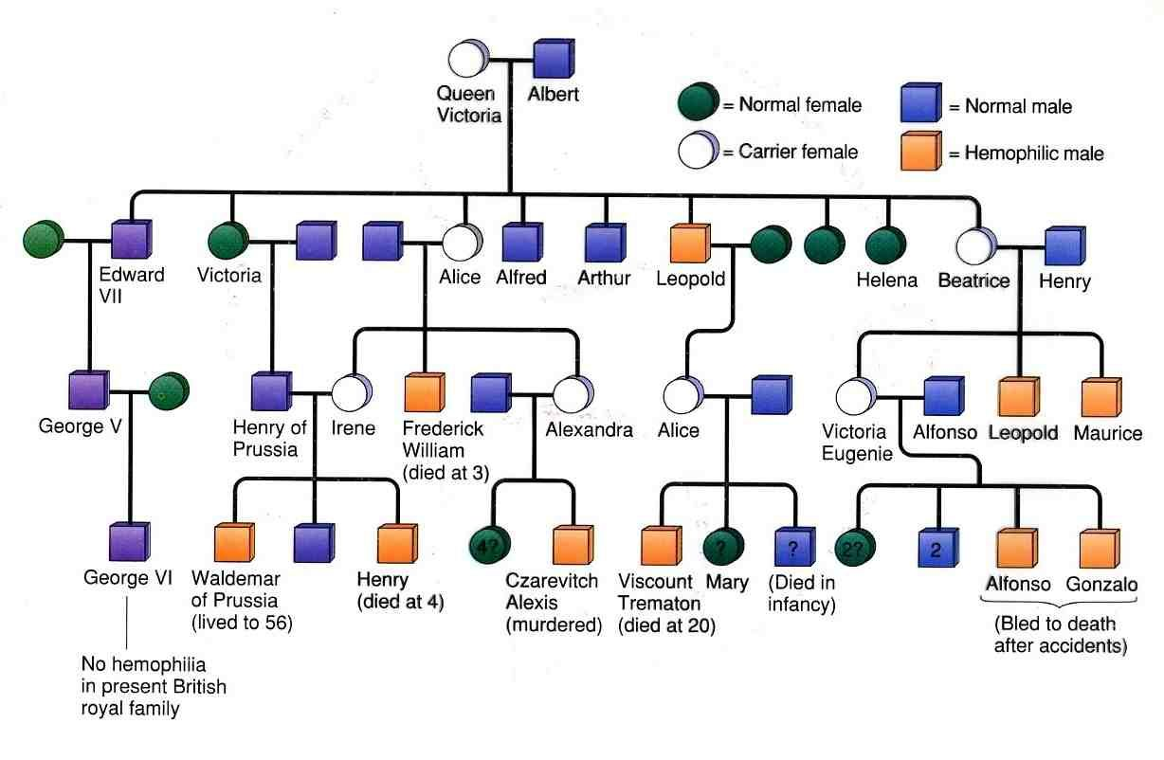
History of Hemophilia

Slide 5
History of hemophilia
Hemophilia is often called the disease of kings, because it was carried by many members of the Europe's royal families around 19th and 20th centauries.
Queen Victoria - I of England, was the carrier of hemophilia B, or factor IX deficiency.
Hemophilia was carried through various royal family members for three generations after Victoria, then disappeared.
It was first coined by “ Scholein 1820s”.
Originally termed as “Haemorraphilia”.

Slide 6
Causes of Hemophilia
Hemophilia A and B are caused by a flaw in a part of a gene.
A sex-linked recessive inheritance.
Since it is located on X chromosome, usually occurs in males (infected) and females are its carriers.
Caused by clotting factors of VII, IX or X.

Slide 7
Types And Causes of Hemophilia
Hemophilia A :
Lack of blood clotting factor VIII
Hemophilia B:
Deficiency of factor IX
Hemophilia C:
Lack of clotting factor XI
Von Willebrand Disease:
Also know; - Von Willebrand Factor or Ristocetin Cofactor which is reduced.
Parahemophilia: Lack of clotting factor V.

Slide 8
Hemophilia A
Classic hemophilia or Factor VIII Deficiency.
Lows levels of a blood clotting factor called figure 8 (FVIII).
Mild Hemophilia A: Do not have spontaneous bleeding (diagnosed In later Life).
Moderate Hemophilia A: Spontaneous bleeding (Diagnosed before they are 5-to-6-year old’s).
Severe Hemophilia A: Spontaneous Join (Diagnosed within two yrs. of life) .

Slide 9
Hemophilia B
Christmas disease or Factor IX Deficiency.
Figure 9 (FIX)
Two types of mutations: FVII gene – Hemophilia A and FIX gene – Hemophilia B.

Slide 10
Symptoms
Bleeding into a joint or muscle, which causes pain and swelling.
Bleeding that is not normal after an injury or surgery.
Easy bruising.
Frequent nosebleeds.
Blood in the urine.
Bleeding after dental work.
PTO→-→

Slide 11
Symptoms
Some people with milder type of diseases may not have symptoms until later life. Mostly Hemophilia symptoms are noticed during infancy or childhood.
Symptoms noticed during infants are:
Bleeding into the muscle, which causes a deep bruise after the baby gets a routine vitamin K shot.
Bleeding that goes on for a long time after the infant's heel is pricked to draw blood for newborn screening tests.
Bleeding in the scalp or brain after a difficult delivery or after special devices (vacuum or forceps) are used to help deliver the baby.

Slide 12
Conclusion
Hemophilia is congenital lifelong disorder. The goals of the treatment should be to minimize disability and prolong life, to facilitate general social and physical well being and to help each patient achieve his full potential.
Now the treatment with blood clotting factors is as safe as it can be made.
Prophylaxis.
Synthetic factor VIII an IX are now available in the market, and carry even smaller risks of viral contamination, and are potentially free of supply problems, at least in developing countries.
Finally, great advances have been made in genetics over the years. There is now the possibility that the use of gene therapy may be feasible at some time in the future to help to alleviate the severity of people’s hemophilia.

Slide 13
Summary
Hemophilia is a bleeding disorder that slows the blood clotting process. People with this condition experience prolonged bleeding or oozing following an injury, surgery, or having a tooth pulled. In severe cases of hemophilia, continuous bleeding occurs after minor trauma or even in the absence of injury (spontaneous bleeding).
Serious complications can result from bleeding into the joints, muscles, brain, or other internal organs. Milder forms of hemophilia do not necessarily involve spontaneous bleeding, and the condition may not become apparent until abnormal bleeding occurs following surgery or a serious injury.
The major types of this condition are hemophilia A (also known as classic hemophilia or factor VIII deficiency) and hemophilia B (also known as Christmas disease or factor IX deficiency). Although the two types have very similar signs and symptoms, they are caused by mutations in different genes. People with an unusual form of hemophilia B, known as hemophilia B Leyden, experience episodes of excessive bleeding in childhood but have few bleeding problems after puberty.

Slide 14
Reference
Haemophilia (slideshare.net)
Hemophilia Types | Stanford Health Care
HEMOPHILIA (healthnet.org.np)
Hemophilia - Conditions - GTR - NCBI (nih.gov)
Hemophilia — The Royal Disease That Started From Queen Victoria I | by Hdogar | Lessons from History | Medium

Slide 15

THANK YOU

